Slide 1
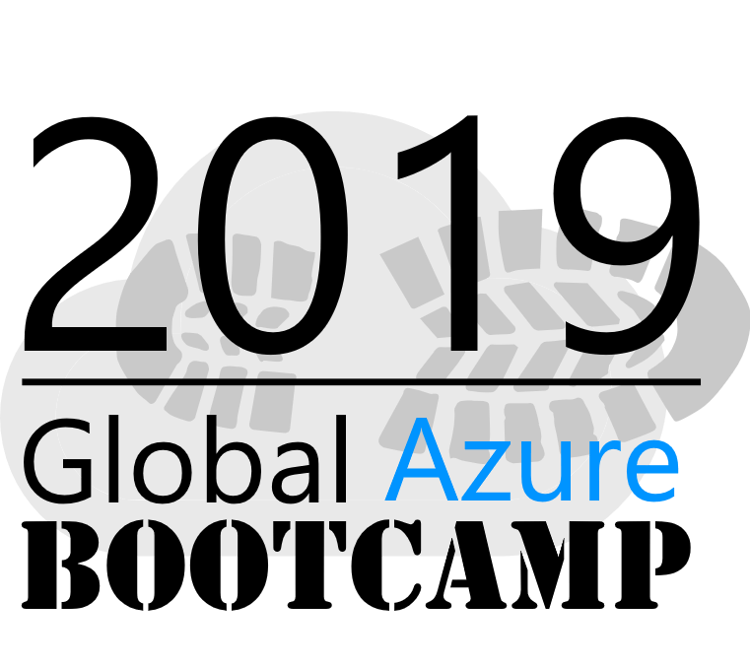
Welcome to the
Bengaluru, India

Slide 2
An Overview of Microsoft Azure Stack
Notes:
Before starting get to know the audience. How many of you know what Azure Stack is, raise hands please. For those of you who don’t I promise you will walk away with that knowledge.

Slide 3




Jayanth Dattatri YK
@YkJayanth
https://www.linkedin.com/in/jayanthdattatri/
Principal Product Technologist at Dell EMC – Asia Pacific and Japan | Dell EMC Cloud for Microsoft Azure Stack
17+ years of IT industry experience in Storage, Systems Management and Cloud Technologies
Community Lead, Author and Speaker
Jayanth_yk@dell.com

Slide 4
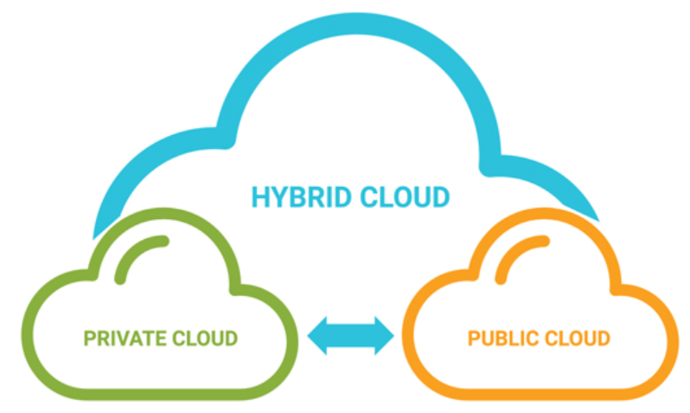
Agenda
Why Hybrid Cloud?
Why Microsoft for Hybrid Cloud?
Why Microsoft Azure Stack?
Azure Stack Use cases
Azure Stack Architecture
Azure Stack Hardware Architecture
Azure Stack Monitoring and PnU
Demo

Slide 5
Why Hybrid Cloud?

Slide 6

The new digital customer
Rising and continuously changing expectations around experiences
Always available
Real-time updates
Intelligent interactions
Intelligent applications are the new face of business
Notes:
For the new digital customer, user experience trumps all, with rising and continuously changing expectations for intelligent applications – always available, with real-time updates and intelligent interactions. Intelligent applications are the new face of business.
Virtually all enterprise IT organizations will be expected to manage the delivery of consistent end-user experience SLAs and compliance with regulatory and corporate information management requirements and vendor risk management best practices as hybrid cloud architectures become more complex and dynamic.
The majority of enterprise IT teams will need to gain up-to-date insight into the state of critical cloud-related open source standards and be able to evaluate how to best take advantage of these technologies across hybrid architectures during 2016.
More than half of enterprise IT teams will need to create new cloud management roles with responsibility for leading policy discussions with major business stakeholders, vetting public cloud service selections, and auditing ongoing SLAs, vendor performance, and compliance with data protection and security requirements by the end of 2016.
Public IT cloud services spending is predicted to reach over $112 billion in 2019, with a compound annual growth rate (CAGR) of 18.3% — about six times the rate of overall IT market growth.
In 2019, public IT cloud services will drive nearly 20% of the $675 billion aggregate spending in applications, development and deployment tools, infrastructure software, storage, and servers, and they will account for 59% of spending growth.
IDC has identified multiple key drivers that represent significant forces affecting cloud sourcing and deployment decisions by enterprises, they are;
Accelerating business disruption from digital transformation
Shifting global economic power, balance, and influence.
Cloud platform gravity attracts IT energy and activity
Rise of DevOps accelerates cloud-native application development.
Modularization of IT through convergence, SD(X), hyper-scale and containers.
High demand for next-generation business/IT skills, but scarce supply
The merging of real life with digital identity

Slide 7
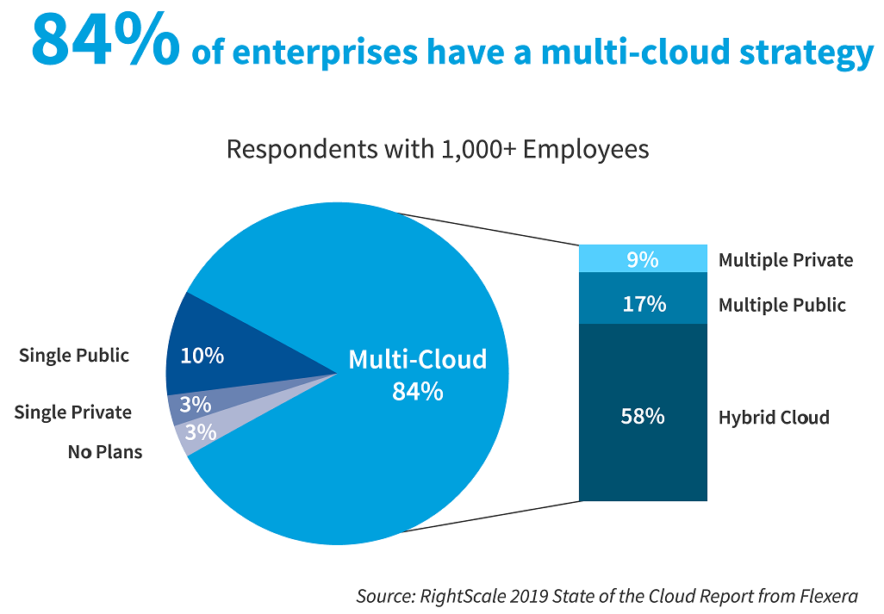
What Analysts Say?
Notes:
RightScale was recently acquired by Flexera, a provider of technology asset management solutions that help enterprises gain insights on how to optimize spend and reduce risk. The same RightScale cloud industry research team that has been producing the State of the Cloud Report for the past eight years has joined Flexera, and has again conducted the annual State of the Cloud Survey and prepared the resulting analysis for the RightScale 2019 State of the Cloud report from Flexera.
In January 2019, Flexera surveyed 786 technical professionals across a broad cross-section of organizations about their adoption of cloud computing.

Slide 8
Why Microsoft for Hybrid Cloud?

Slide 9
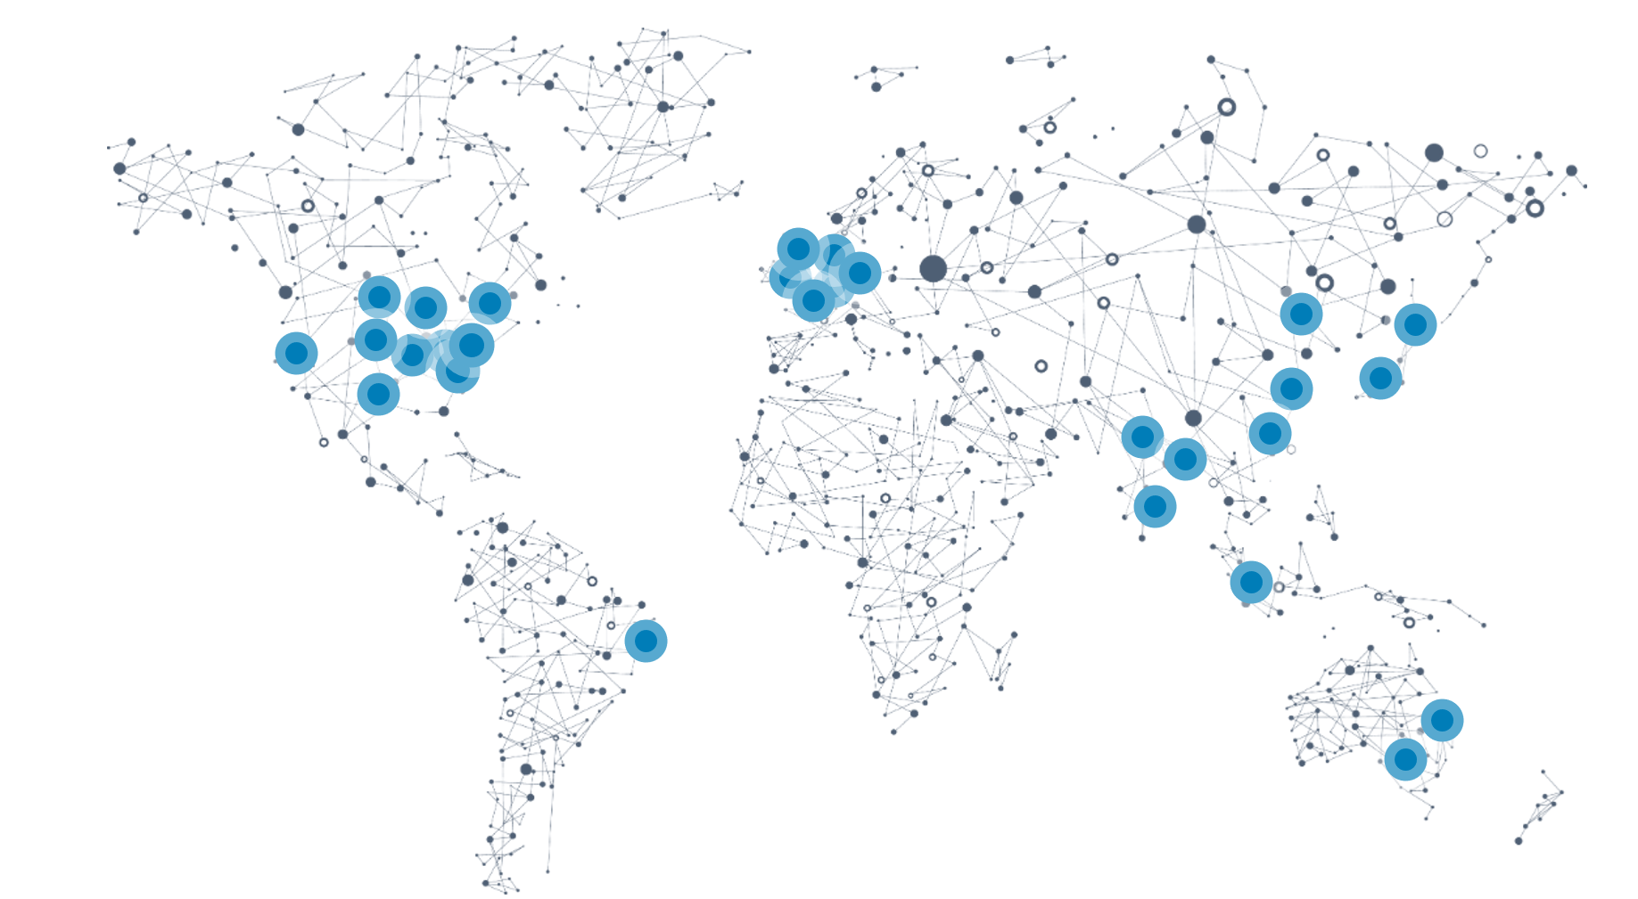

Why Microsoft for Hybrid Cloud?
54
datacenter regions
More than AWS and Google Cloud combined
Notes:
Public cloud regional datacenters with geographic diversity. Customers can deploy two identical workloads in different regions with an Active/Active failover model. This can ensure business continuity in the event of a local disaster.
Local and sovereign cloud – in-country Microsoft datacenters to address data residency (like Canada), we’re using a combination of technology as well as a legal framework to legally isolate certain regions of the world according to local sovereignty, governance, and rule of law, all the while providing the same exact up to date set of services in those regions
There are four sovereign clouds today and four more planned
US Gov (2)
China North Beijing
China South Shanghai
Planned:
Germany Central
Germany Northeast
US DoD East
US DoD West

Slide 10
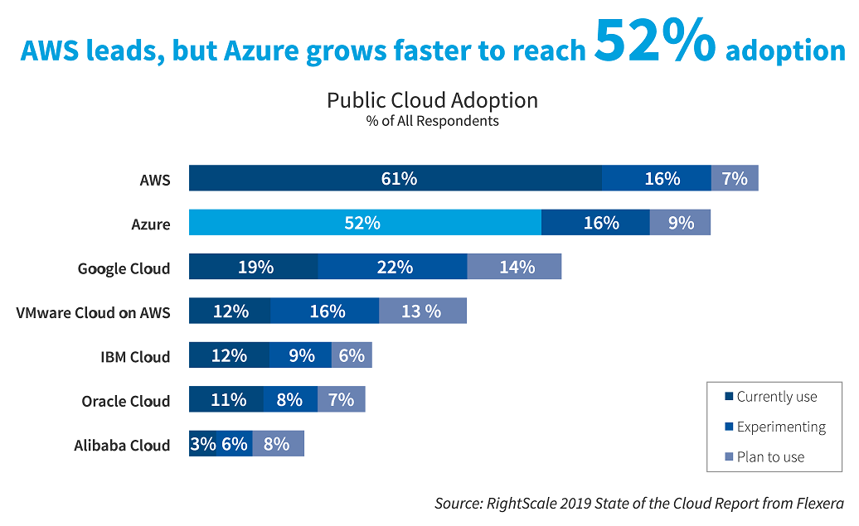
Adoption Continues to Climb
Notes:
Overall Azure adoption grew from 45 to 52 percent to narrow the gap with AWS. As a result, Azure adoption has now reached 85 percent of AWS adoption, up from 70 percent last year.

Slide 11
Microsoft hybrid cloud strategy
Legacy IT
New IT Reality
Implementation Options
Target Cloud Platform
Physical Servers and Virtual Machines
On-premises, non-cloud
Microsoft Azure Stack and Public Services
Replace
SaaS: Microsoft Dynamics, Office 365
Hybrid Cloud
Modernize
PaaS: Microsoft Azure and Microsoft Azure Stack
Public Cloud
Migrate
IaaS: Microsoft Azure and
Microsoft Azure Stack
Agility
Advanced Enterprise Virtualization
Support for Legacy Apps and IT
Windows Server 2016 Hyper-V
System Center 2016
SQL Server 2016
Private Cloud

Slide 12
Why Microsoft Azure Stack?

Slide 13
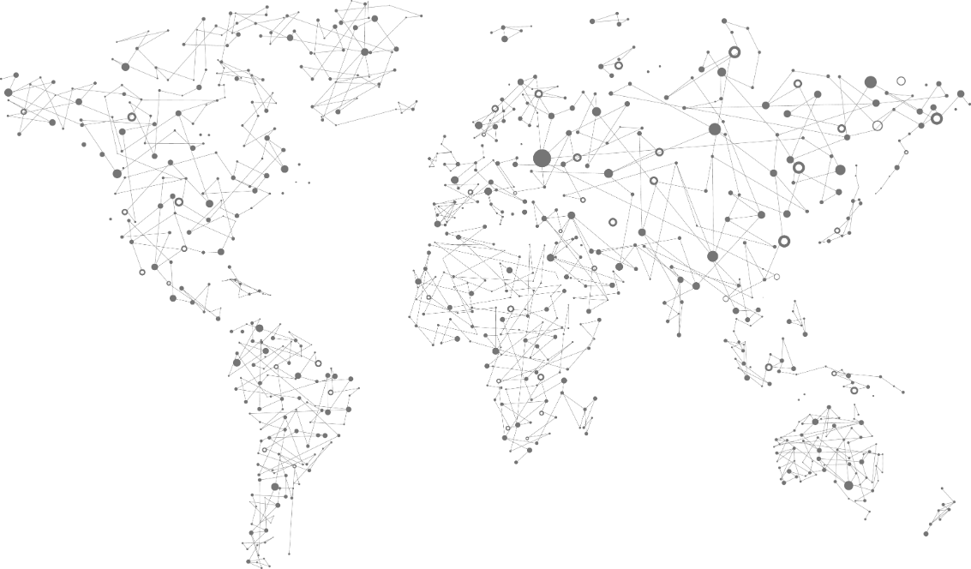
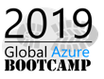
One Azure Ecosystem
54 Azure regions
100s of service providers
1,000s of enterprises
Notes:
The vision with Azure and Azure Stack is to enable Azure services everywhere.
There are 54 Azure hyper-scale regions today (announced + operational)
(Click) The expectation is that 100s of service providers to join in with their own Azure Stack datacenters offering differentiated services to their customers.
(Click) And then 1000s of enterprises who will want to adopt the Azure model to serve the speed and innovation needs of their business.
All coming together.
With the intent of delivering Azure innovation everywhere.

Slide 14
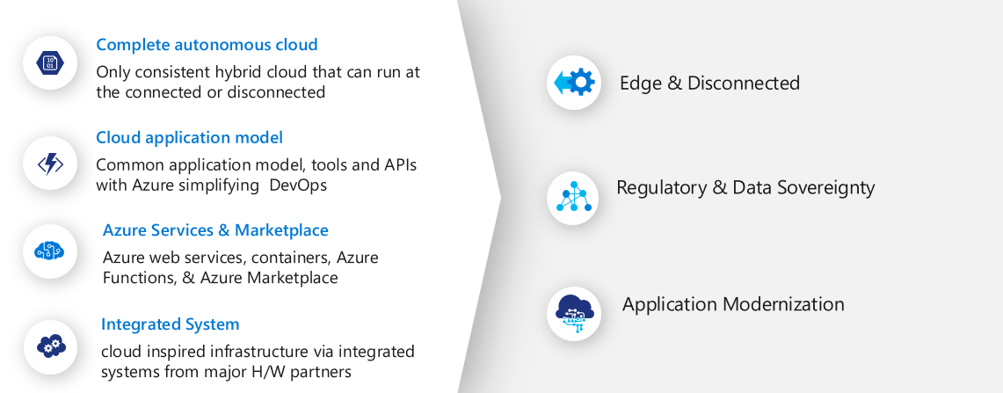
The Azure Stack
Notes:
Remember you are in Microsoft Azure Stack
Complete autonomous cloud: Talk about consistency between Azure and Azure Stack
Cloud Application Model: Talk about the common application model like tools, APIs
Azure Services and market Place: web servers, containers, functions
Integrated system: Cloud inspired HW infra through H/W partners
Edge and Disconnected: How many of you have come across customers who has a factory that doesn’t have proper internet connection? There are scenarios where in one needs to understand the insights into how the processes are doing, efficiency of production output etc.
Regulations: Although Azure and Azure Stack are the most certified public and private cloud, some customer simply do not want to put their data into public cloud, data can’t leave the boundary of the country. Credit card data, or law regulation etc.
Application Modernization: Bring the app model on premises.

Slide 15

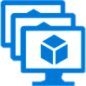

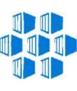





Azure Services on premises with Azure Stack
Azure IaaS on-premises
Azure PaaS available on-premises
Virtual Machines (VM)
VM Scale Sets
Azure App Service
Developers
Containers
with Docker
Azure Functions
One Azure ecosystem
Networking
Unified app development
Azure Service Fabric
Azure services in your datacenter
Storage – Blob, Tables, Queues
Cloud Foundry
IT
Additional Azure services delivered through Azure Stack updates
Notes:
With Dell EMC Hybrid Cloud for Microsoft Azure Stack you have one hybrid cloud for delivering an automated, consistent experience for both traditional and cloud-native apps. This is because Azure Stack was built specifically for the cloud and the apps, services and tools are consistent with those available in the Azure public cloud.
There is no need to learn new tools to support IaaS and PaaS implementations or to administrate, automate and orchestrate lifecycle maintenance and operations tasks. Once a customer understand how to use the tools within Azure public cloud, they know how to use Azure Stack as well. Learn once, deploy and operate anywhere many times over.
One Azure ecosystem with identical tools for users/developers and IT operations teams – all managed with a consistent experience.

Slide 16
Consistent Application Development Experience
DESCRIBE | DEPLOY | CONTROL
Write once, deploy to Azure or Azure Stack
Identical application model with same APIs
Azure Resource Manager
Gallery
Azure Resource Manager
Role-Based Access Control (RBAC)
Service definition
Consistency
Choice of open source application platforms, languages, and frameworks
Microsoft Azure Stack
Microsoft Azure
Notes:
The power of Azure allows developers to write their applications once and deploy anywhere in Azure or Azure Stack. Both have an identical application model with the consistent APIs.

Slide 17
Deployment Option - Connected
A connected deployment is the default option because it allows customers to get the most value out of Azure Stack.
Identity Store Options
AD FS
OR
AAD
Billing Model Options
Capacity Based
OR
Consumption Based
Azure Subscription Options
EA
OR
CSP
Certificate Authority
Internal
OR
Public
Notes:
Azure AD is a cloud-based identity service. It has built in support for synchronizing with your existing on-premises Active Directory or can be used stand-alone. This means that all your applications, whether on-premises, in the cloud (including Office 365), or even mobile can share the same credentials. Administrators and developers can control access to internal and external data and applications using centralized rules and policies configured in Azure AD.
When you use AAD, it requires 2 AAD accounts. A global Admin Account and a billing account. This can be same or different.
- Global Admin account will be used as a Cloud Operator. This is required for only connected deployment
- Billing Account: Required for both connected and disconnected deployments. This is required to establish relationship between Azure Stack and Azure commerce backend
ADFS: Choose this option if you want to use your own identity store, such as your corporate Active Directory, for your Service Administrator accounts.
Billing Model: You can use Capacity Based or Consumption Based (Pay-as-you-use) billing models.
Pay-as-you-use model: Azure Stack brings the cloud economics model to on-premises environments. You begin running services with no upfront licensing fees and you pay only for what you use, just like in Azure. Because you take on the hardware and operating costs, Azure Stack service fees are typically lower than Azure prices.
Note: If you bring you own license, you will be charged only the Azure Stack base virtual machine fees. For example, if you bring an MSDN Windows Server license and deploy a Windows Server virtual machine on Azure Stack, your consumption would be metered only at the base virtual machine rate.
Capacity model: If you need to use Azure Stack in a disconnected mode, Microsoft offers a capacity model pricing package, which
allows you to license all the physical cores in your deployment with a fixed fee annual subscription. Two capacity packages are available to meet your workload needs: the App Service package, which includes App Service, base virtual machines, and Azure Storage ($400/core/year), and the IaaS package, which includes base virtual machines and Azure Storage ($144/ core/year.) With the capacity model, you use your existing on-premises licenses to deploy Windows Server and SQL Server virtual machines. The capacity model is available via EA only. It is purchased as an Azure Plan SKU via normal volume licensing channels.

Slide 18
Deployment Option - Disconnected
A disconnected deployment may be desired for security or other reasons. Carefully review limitations for these deployments.
Identity Store Options
AD FS
OR
AAD
Billing Model Options
Capacity Based
OR
Consumption Based
Azure Subscription Options
EA
OR
CSP
Certificate Authority
Internal
OR
Public
Notes:
Choose this option if you:
Have security or other restrictions that require you to deploy Azure Stack in an environment that is not connected to the Internet.
Want to block data (including usage data) from being sent to Azure.
Want to use Azure Stack purely as a private cloud solution that is deployed to your corporate Intranet, and aren’t interested in hybrid scenarios.
Note: You can deploy and use Azure Stack without a connection to the internet. However, with a disconnected deployment, you are limited to an AD FS identity store and the capacity-based billing model. Because multitenancy requires the use of Azure Active Directory (Azure AD), multitenancy is not supported for disconnected deployments.
A disconnected deployment does not restrict you from later connecting your Azure Stack instance to Azure for hybrid tenant VM scenarios. It means that you don’t have connectivity to Azure during deployment or you don’t want to use Azure AD as your identity store.

Slide 19
Disconnected - Limitations
Identity Store
Limitations
Marketplace syndication requires separate connected device.
Registration requires separate connected device.
P&U requires separate connected device.
See full list at https://docs.microsoft.com/en-us/azure/azure-stack/azure-stack-disconnected-deployment under “Features that are impaired or unavailable in disconnected deployments”
AD FS
Billing Model
Capacity Based
Azure Subscription
EA
Certificate Authority
Internal
Notes:
https://docs.microsoft.com/en-us/azure/azure-stack/azure-stack-disconnected-deployment#features-that-are-impaired-or-unavailable-in-disconnected-deployments

Slide 20
Azure Stack Use Cases

Slide 21


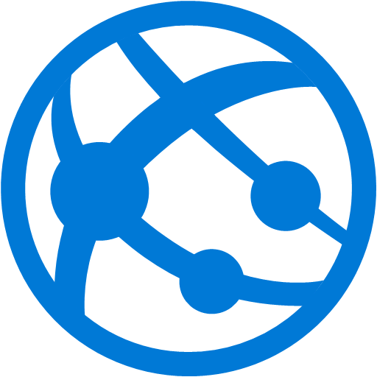
Changes to application code and ARM template
Code and ARM template checked into Azure Repos
Automatic application build and unit tests
Orchestrated deployment of application artifacts with environment-specific parameters
Application runs on App Service on both Azure and Azure Stack
Hybrid DevOps
2
3
4
5
1
App service
App service
Azure Stack
Azure
Notes:
Implementing a continuous integration/continuous development (CI/CD) approach to deploying applications becomes difficult when on-premises applications are built and operated in different ways than cloud applications. Having a consistent set of development tools and processes across the Azure public cloud and on-premises Azure Stack environments makes it far easier for organizations to implement a practice of CI/CD. Apps and services deployed the right way in Azure and Azure Stack are essentially interchangeable and can run in either location.
ARM: Azure Resource Manager. How many have you written an ARM template before? It allows you to manage VMs, Network resources and Storage resources in a logical ways that makes sense to you. Allows you to incrementally update your applications. ARM automatically calculates the changes and applies them. It manages quotas, subscription, access etc. ARM templates are JSON documents

Slide 22
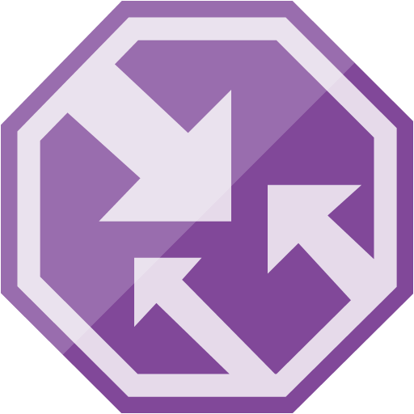
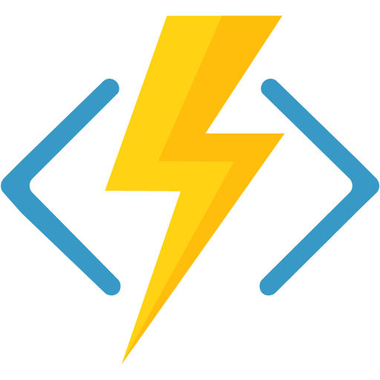
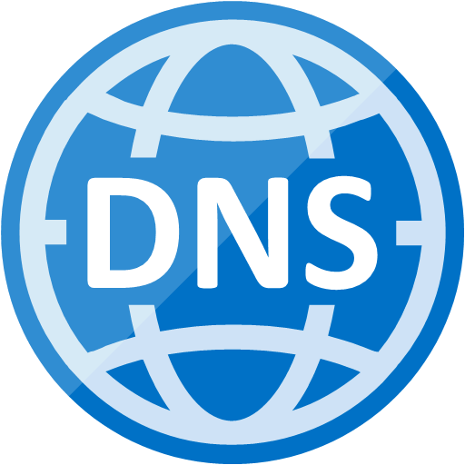
Users attempt to access the web app
Traffic manager returns the Azure Stack DNS name
Users load the Azure Stack web app
Once a threshold is reached, a function starts the Azure Web App and enables the Azure Traffic Manager Route
Traffic is routed to Azure
Hybrid Scaling
Azure
5
1
4
2
Azure Stack
3
Notes:
Modern software is increasingly connected and distributed. The consistency of Azure Stack with Azure infrastructure and platform services enable you to scale resources cross cloud to meet increased load as needed, and decrease resources as demand drops. Optimize cost and maximize resource efficiency while remaining compliant with cross cloud architecture
Traffic Manager uses the DNS server that's closest to the user to direct user traffic to a globally distributed endpoint.
1. A large numbers of users attempt to access the web app.
2. Traffic manager returns the Azure Stack DNS name.
3. Users access the Azure Stack web app.
4. Once a threshold is reached, a function starts the Azure Web App and
enables the Azure Traffic Manager route.
5. Traffic routed to Azure, which can automatically scale App Service.

Slide 23

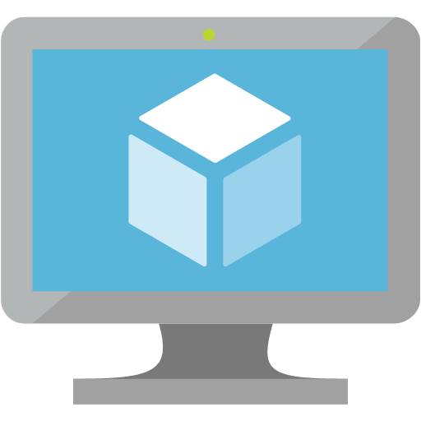

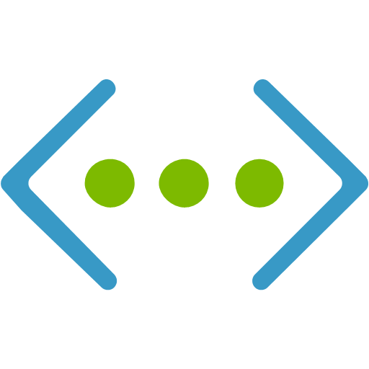
User enters data into Azure-based web app
Application commits data to database over VNet to VNet VPN connection to Azure Stack
Data is stored in SQL database on VM in Azure Stack
Data Sovereignty & Data Gravity
Azure
Azure Stack
1
2
3
Notes:
I have data that will continue to remain in an on-premises environment because it is impractical or against my organization policy to move it to the cloud. Still, I am looking to take advantage of public cloud innovation and adopt services to modernize my applications that leverage this data.
Azure with Azure Stack enables organizations to make technology placement decisions based on business needs—simplifying meeting custom compliance, sovereignty and data gravity requirements.

Slide 24
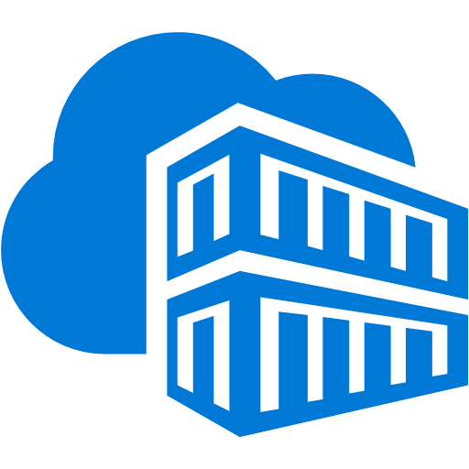
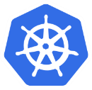


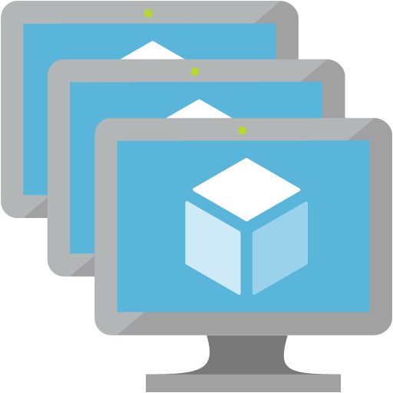
A model is trained in the cloud using Azure ML tools and containerized
The model is deployed to a Kubernetes cluster on Azure Stack
Input is scored against the model
Insights from scoring are placed into a queue
Compliant data and insights are sent to Azure
Global insights are available in the global app
Data from edge scoring is used to improve the model
AI at the Edge
Azure
Azure Stack
1
2
3
7
5
4
6
Notes:
With the Azure AI tools and cloud platform, the next generation of AI-enabled hybrid applications can run where your data lives. With Azure Stack, bring a trained AI model to the edge and integrate it with your applications for low-latency intelligence, with no tool or process changes for local applications

Slide 25
Azure Stack Architecture

Slide 26




Azure Stack architecture summary
Guest workload resources
(IaaS + PaaS)
Storage blobs
Websites
(.NET, PHP, Python … )
Virtual machines
(Linux or Windows)
Virtual networks
Service fabric clusters
End-user experiences
Azure Portal | Developer Tools (MSFT and Open Source)
Unified app model
Microsoft Azure Services
Azure Resource Manager
Core services
Subscriptions | RBAC | Gallery | Metrics | Usage
Extensible service framework
Additional services
Additional services
Foundational services
Compute | Storage | Networking | Platform services
Cloud infrastructure
Infrastructure management
Third-party services
Compute
Storage
Networking
Notes:
Here we have a logical representation of the Azure Stack Architecture.
<Click> at the bottom we see the physical constructs we talked about in the last module. Essentially this represents the hardware layer of the stack.
<Click> Moving up the diagram we have a layer that provides the Extensible Service Framework.
This layer includes the “black box” configuration layer called out as “Foundational Services” and “Core Services” which contain things such as the Azure Stack Marketplace Gallery, Usage tracking, Subscriptions, and so forth”
And last but not least “Additional Services” which are additional services that can be either Microsoft or ISV provided.
As this is an Extensible Service Framework – this layer Provides a way for ISVs to add their unique and differentiated capabilities to the framework. <Click>
The Azure Resource Manager or ARM interface between the user and the underlying resources – all management of the underlying resources is brokered through the Resource Manager. Here is where Azure Stack provides the consistent APIs between Azure and Azure Stack. <Click>
So no matter what tool is desired by the wide variety of IT Service Consumers, Azure Stack provides an “engineer once, deploy to public or on-prem” experience based on ARM’s capabilities.

Slide 27
Dell EMC Azure Stack

Slide 28
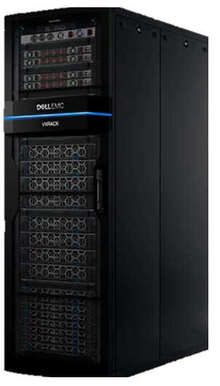

Dell EMC Cloud for Microsoft Azure Stack
Key Design Principles
Integrated system
Software
Hardware
Support
Services
Engineered Approach
Hyper-converged Infrastructure
Architecture, hardware and topology
Deployment, configuration, provisioning
Validation
Monitoring, diagnostics
Sustained
Streamlined Operations
Security and privacy
Business continuity
Patching and updating
Field replacement of parts
Notes:
I’m going to spend the first few minutes reviewing the key design principles we’ve taken with our approach to engineering the Dell EMC Cloud for Microsoft Azure Stack and how our approach makes us unique in the market <click>
Let’s start by reinforcing the fact that Azure Stack is only being delivered as an integrated system. <click> The Dell EMC offering is purpose built to deliver a scalable, reliable, and consistent infrastructure for the Azure Stack software components. This solution has been engineered to be more than an ala carte menu of industry leading servers with top of rack switching. It has been designed to specifically support the Azure Stack Software and tenant workloads and is part of our market leading hyper-converged family of offerings consisting of VxRAIL and VxRACK systems. <click>
Dell EMC Cloud for Microsoft Azure Stack is deployed as an appliance – racked, stacked, cabled, configured, and ready to deploy cloud optimized workloads – and it is supported and maintained as an appliance throughout its lifecycle, not in a piecemeal fashion.
<click>
If we draw back the curtains and look at the software defined underpinnings - Azure Stack is deployed on a Hyper-Converged architecture based on the Microsoft Windows 2016 Storage Spaces Direct and Software Defined Networking capabilities. Dell EMC is the market leader in delivering Hyper-Converged solutions building on the previously mentioned VxRail and VxRack family of products and our experience designing these offerings along with our previous hybrid cloud offerings have greatly influence how we’ve engineered VxRack AS<click>
We have taken a tightly engineered approach to building out our Azure Stack offering. Our experience delivering hybrid cloud based systems has taught us that ala carte server offerings in a cloud model are a recipe for disaster and, in an endeavor to limit the potential for “bad configurations”, our configuration options have been specifically engineered to account for the over riding Azure Stack-based design requirements. In short they’ve been designed specifically with Azure based workloads in mind and not leveraging methodology from more traditional virtualization environments which have different requirements, best practices and use cases.
<click>
Up front engineering only tells part of the story though – sustained engineering will be equally if not more critical to the long term success of Azure Stack deployments.
How we streamline and ease the operational burden on our IT organizations will at the end-of-the-day be a key differentiator in the marketplace.
<click>
The stringent engineering approach we have taken to both initial design and ongoing sustainability, we believe, provides our joint customers with the most stable and sustainable platform for their Azure Stack deployments allowing them to focus on applications rather than core infrastructure management.

Slide 29
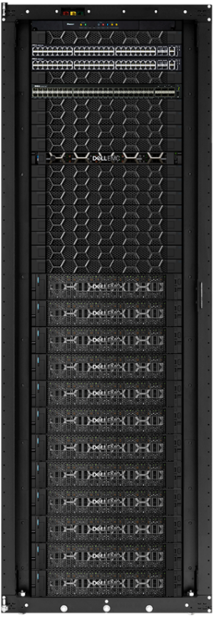
Dell EMC Azure Stack Physical Components
Dual Dell EMC S4048-ON 10gbe ToR Switches
S5048-ON 25gbe available as an option
1 Dell EMC S3048-ON 1gbe OOB Switch
1 Dell EMC R640 Server Hardware Lifecycle Host
Dell EMC R740XD Server Compute Nodes (4,8,12, 16 node configurations)
Notes:
Let’s start by looking at the core physical componentry of the Dell EMC Cloud for Microsoft Azure Stack. <click>
Starting from the top of the rack there are redundant 10 gig Dell EMC s4048 switches that handle all North/South traffic <click>
Next we have a single 1 gig S3048 OOB switch for management <click>
There is a single Dell EMC R640 Server that serves as the hardware lifecycle host. This server has three functions.
During initial deployment it serves as the staging ground to deploy the Azure Stack Software and configure the cluster for use.
It hosts Open Manage Essentials and Open Manage Network Manager for monitoring the hardware health of the Azure Stack and finally but probably most importantly
It serves as the orchestration mechanism for deploying firmware and non-driver hardware updates to the system.
The HLH and the OOB switch are the only two non-redundant components in the stack
<click>
The compute nodes of the cluster consist of 4, 8, or 12 Dell EMC R740XD Servers
Please note Dell EMC has made the engineering decision to deploy Azure Stack clusters only in these increments – Microsoft specifications are only that a cluster must be a minimum for 4 servers, maximum of 12.

Slide 30
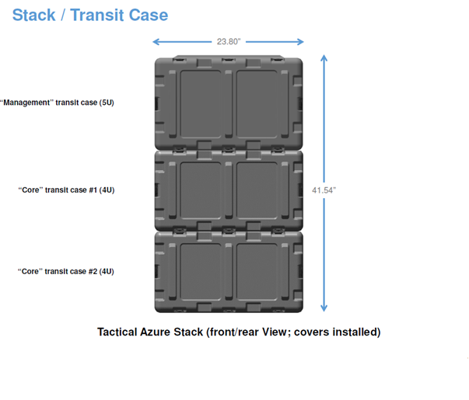
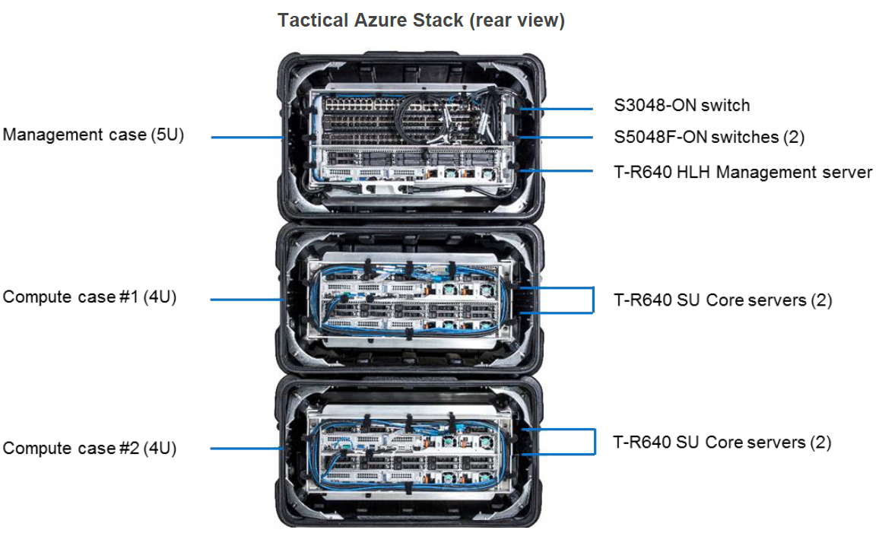
Dell EMC Tactical Azure Stack
Notes:
On February 4th, We announced Tactical Azure Stack, a ruggedized platform for Microsoft Azure Stack. It is the first and only ruggedized platform for Azure Stack. General availability is planned in mid-March for the US only. Other countries will be added throughout the year.
Tactical Azure Stack is the first and only ruggedized Azure Stack product available for tactical edge deployments. Based on our proven all-flash Dell EMC Cloud for Microsoft Azure Stack, it brings an Azure consistent-cloud to operating environments with:
Limited or no network connectivity
Fully mobile, or high portability (“2-person lift”) requirements
Harsh conditions requiring mil spec solutions
High security requirements, with optional connectivity to Azure Government, Azure Secret, and Azure Top Secret.
The Dell EMC Tactical Microsoft Azure Stack offering was developed in partnership with Microsoft and <Click> Tracewell Systems.
Azure Stack use cases
<Click>
It extends Azure-based solutions beyond the traditional data center to a wide variety of non-standard environments, such as tactical deployments in ruggedized environments with limited or completely disconnected access.
At just 41.5 inches high, and 25.63 inch operating depth, the Tactical Microsoft Azure Stack unlocks a wide variety of use cases, <Click> including forward deployed environments, mobile platforms such as shipboard and aerospace applications, along with non-traditional environmental conditions The design goal being MIL-STD-810G compliance.
Verticals <Click>
Verticals for Azure Stack include tactical edge, mobile and hostile environments such as
Military field deployments
Oil rigs/fields
Disaster relief zones
Rural environments
Mining environments
In the back of a truck for mobility purposes
Key features include:
Fully mobile or high portability (2-person lift) requirements
<Click> Uses PowerEdge R640 servers with all-flash
Includes same Dell EMC innovations as on-premise Azure Stack (AS): industry exclusive firmware update automation, as well as consistent services and support
Highly secure requirements, with optional connectivity to Azure Government, Azure Secret, and Azure Top Secret
There is no difference between the Tactical Azure Stack and the Data Center Azure Stack from cloud operator, developer, and tenant perspectives. The core componentry is identical to our all-flash VxRack AS offer. This also includes our industry exclusive firmware update automation, as well as consistent services and support whether a customer is running in a comfortable data center or a mobile-deployed environment.
Exclusive Dell EMC features <Click>
Industry-leading server platform
Automated Lifecycle Management
Integration with Dell IP (Isilon, CloudLink, PCF)
Sold and supported through Dell EMC

Slide 31
Demo – Capacity Planner

Slide 32
Monitoring and P&U

Slide 33
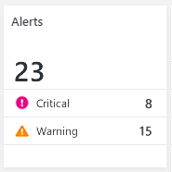
Introduction to Monitoring
Network Switches
Health
Health State in Azure Stack is linked to Alerts
Separate health of cloud services from cloud infrastructure
Actionable alerts
Links to online troubleshooting guides for step by step guidance
Health & Alerts visible in Admin Portal
Alerts generated from:
Internal Health Services
System Health Tests
Monitoring via SNMP
Restful Integration
External DC Monitoring Systems
Out-of-band device monitoring
Server Nodes

Slide 34
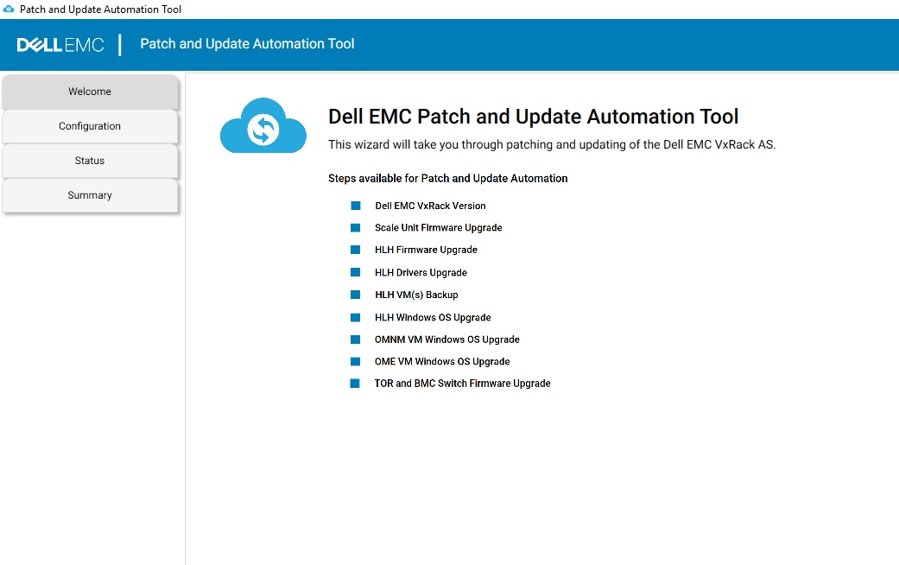
Dell EMC Hardware Patch and Update Automation
Automation of Scale Unit Nodes and HLH P&U
Streamlined process reduces risk and keyboard time for Operators
Includes Automation of Switching updates for Dell EMC Switching
Notes:
As part of our ongoing commitment to provide the most sustainable and automated Azure Stack platform on the market we are pleased to announce that the current release of the Dell EMC Cloud for Microsoft Azure Stack (1805) delivers a preview of our Automated Update tooling for our 14g based systems!
It includes automation of Hardware Patch and Update for the compute node updates as well as the HLH.
For the time being, in order to get access to the tool you must work through your TAM to gain access. This allows us to track who is leveraging the tool and allows us to work with you directly as you run through your initial updates via the automated process.
Now let’s take a glimpse of what the tooling and process look like: First, you will download the available updates and put them somewhere accessible by the tool.
You will then launch the tool that is provided by Dell EMC getting a window that looks like this <click>
Upon clicking “Next” you will be queried to provide a set of information including the location of the downloaded update packages, IP ranges for the iDRACs on your nodes, and the appropriate credentials. <Click>
Note the HLH and Azure Stack compute nodes can be scheduled together or done individually with a simple check box depending on your requirements.
Please be aware that if updating the firmware on the HLH you will be prompted to suspend Bitlocker on the HLH.
From here I click to initiate the update process and the tool runs through the process including bringing the nodes in an out of maintenance mode, validating success, and providing status. <Click>
This process will take some time (think hours) but no further Operator interaction is required until the updates are completed.
The net of this is the total operator interaction on a successful update is minutes. There is no series of repetitive tasks to preform introducing increasing risk of human error, outages, or configuration drift.

Slide 35
Demo – Hybrid Scaling

